Slide 1
Semantic Tableaux
Fătu Samuel

Slide 2
Problem Statement
Exercise 6
Using the semantic tableaux method check whether the following logical consequences hold.

Slide 3
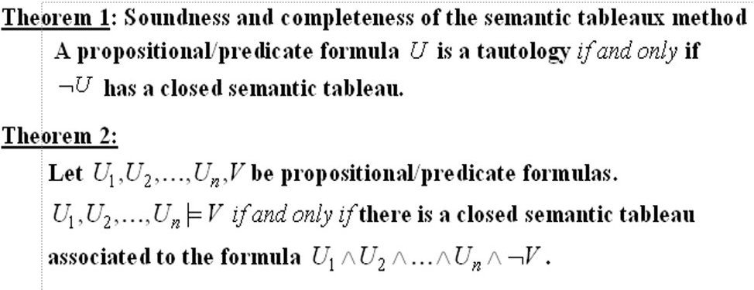
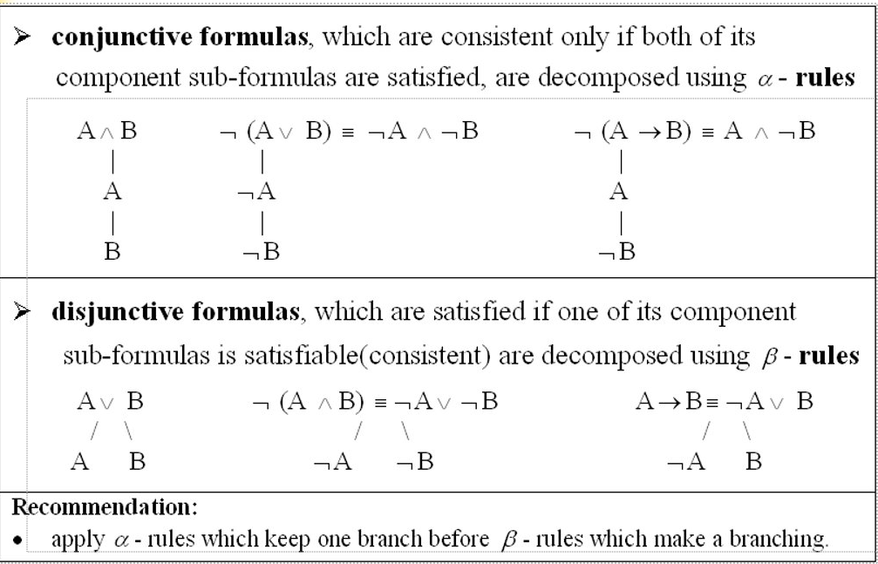
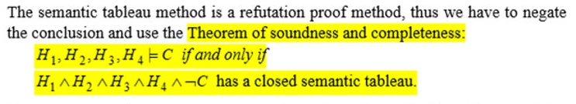
Theory

Slide 4
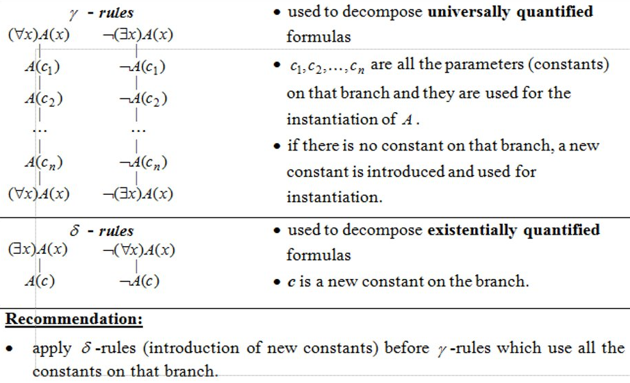
Theory

Slide 5
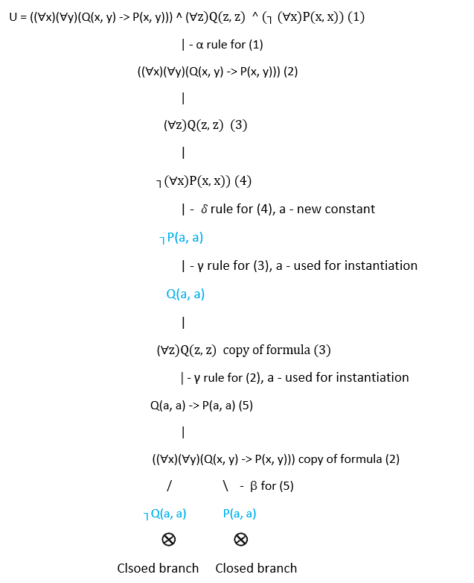
Solution

Slide 6
Conclusion
All branches are closed therefore the logical consequences hold.

